Slide 1
ONE PERSON IN GROUP-> CLICK USE TEMPLATE
WHEN THE COPIED TEMPLATE OF THESE SLIDES OPENS IN A NEW TAB:
ADD YOUR Group NAME TO THE TITLE
SHARE WITH GROUP MEMBERS (USE SHARE BUTTON)
COPY THE TITLE AND LINK TO YOUR RECORDS (Digital folder/table of contents)
Remember it is advisable to make a PERSONAL copy and link it when DONE

Slide 2
Solubility Table and Double Displacments

Slide 3
ESSENTIAL QUESTIONS
Remember, you should be able to thoroughly answer these AFTER learning through following resources.
What are the predictable ways elements and compounds come together in double displacement reactions?
How do precipitates form during double displacement reactions?
How can we predict the solubility of various ionic compounds using a solubility table

Slide 4
Instructions
Follow through the Engage to Apply resources in order .
Once complete, choose from Extend resources as interested.
Record your learning in your these slides- Remember to keep track of where to find these slides for studying!
Complete the Essential Questions Response in the Apply Section.
Try the Extend section and optional Apply practice as desired to deepen your understanding

Slide 5
Hyperdoc Elements
Click for quick access to:
Engage
Explore
Explain
Apply
Extend

Slide 6
Terminology - As you encounter terms new to you, define in your own words here, include examples (make them up!)

Slide 7
Part 1: ENGAGE
(5 mins)

Slide 8
As a group discuss the following
What do the terms soluble and insoluble mean?
Which of the following do you think are most likely to be insoluble? Hint: Recall what we learned about charge and size of ions.
LiCl MgS PbI₂

Slide 9
Speed challenge on SINGLE displacement reactions
Using your metal and halogen activity series, race against your group mates to predict whether the following reactions will take place.
Click to the next slide to check your answers once you are done!
Pb + Zn(C₂H₃O₂)₂ →
AgNO₃ + Ni →
Ag + H₂SO₄ →
NaI + Br₂ →

Slide 10
Speed challenge on SINGLE displacement reactions
Using your metal and halogen activity series, race against your group mates to predict whether the following reactions will take place.
Click to the next slide to check your answers once you are done!
Pb + Zn(C₂H₃O₂)₂ → NR
AgNO₃ + Ni → Ni(NO₃)₂ + Ag
Ag + H₂SO₄ → NR
NaI + Br₂ → NaBr + I₂
Move this box to see answers

Slide 11
Part 2: EXPLORE

Slide 12

Explore: Watch & learn
Pause at the 4 minute mark and predict the solubility of the compounds. Continue video to check your work

Slide 13
Make sure you can define the following terms:
Soluble
Aqueous
Insoluble
How do we indicate in a chemical formula that it is aqueous or insoluble?
Precipitate
Precipitation (NOT the kind that falls from the sky !)

Slide 14
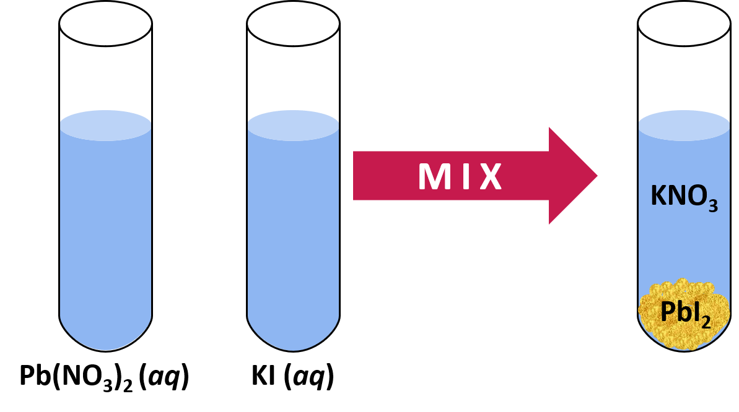
Precipitates
A precipitate is formed when two soluble salts/ionic compounds react in solution to form a new insoluble product

Slide 15

Predict the success of a double displacement reaction!
At a white board, determine if the reactions to the right will form a precipitate:
1. Write the two reactant FORMULAS
2. Determine the two possible products
3. Use the solubility table to determine the solubility of BOTH products
Reactants:
1. MgBr2(aq) + AgNO3(aq)
2. Silver nitrate + potassium phosphate
3. CuBr₂ + AlCl₃
Note: you don’t need to balance for this activity

Slide 16
Photo of board work
Explain why there is no reaction if neither product forms a precipitate (what is happening at the level of ions in water before and after the reactant solutions mix).

Slide 17
What makes a reaction?
If BOTH products are soluble, has a reaction occurred?
Hint: on your board, draw a beaker of the reactants dissolved and a beaker of the products dissolved.

Slide 18
Part 3: Apply

Slide 19
Explain - Check in
Explain the difference between a precipitate that forms from a supersaturated solution and the precipitate that is formed in a double displacement reaction.
Diagrams are beneficial!

Slide 20
Practice Worksheet
Go to the folder and take one of the double displacement reaction practice worksheets.
Work independently to complete as many of the problems as necessary until you are confident. Be sure to check your answers as you go along.

Slide 21
Taking it Further: Generate your own double displacement reaction!
If you are given one (1) of the products, determine two potential reactants that would generate the product for both of the double displacement reactions on the right.
 | Product
Reaction 1 | Ag₃PO_{4(s)}
Reaction 2 | CuCl_{(s)}

Slide 22
Next slide(s) provide answers to activities

Slide 23
ANSWERS: USE IF YOU WERE AWAY Predict the success of a double displacement reaction!
Reactants:
1. MgBr2_{(aq)} + AgNO3_{(aq)}
2. Silver nitrate + potassium phosphate
3. Ca(NO₃)_{2 (aq)} + HCl _{(aq)}
Note: you don’t need to balance for this activity
Products:
1. MgNO3_{(aq)} + AgBr_{(s)}
2. Ag3PO4_{(s)} + KNO3 _{(aq)}
3. CuCl2 _{(aq)} + AlBr3 _{(aq)}
If ONE product precipates the reaction occurs. If BOTH products remained soluble, ions remain separated and there is NO reaction (NO new substance forms)

